Slide 1
Introduction to AWS

Slide 2
Overview of Cloud Computing

Slide 3
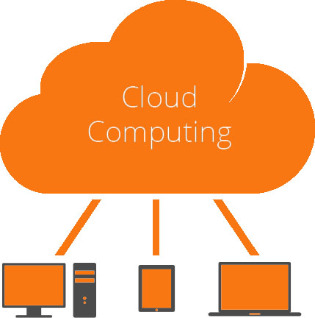
What is Cloud Computing
Cloud computing is the delivery of computing services - servers, storage, databases, networking, tools and software over the Internet.
Cloud computing enables companies to consume a compute resource, such as a servers, storage or an application, as a utility like water or electricity, rather than having to build and maintain computing infrastructures in house.
Companies offering these computing services are called cloud providers and they charge for cloud computing services based on usage.

Slide 4
Cloud Computing: Definition
Cloud computing is a model for enabling ubiquitous, convenient, on-demand network access to a shared pool of configurable computing resources (e.g., networks, servers, storage, applications, and services) that can be rapidly provisioned and released with minimal management effort or service provider interaction.
This cloud model is composed of
Five essential characteristics
Three service models
Four deployment models.

Slide 5
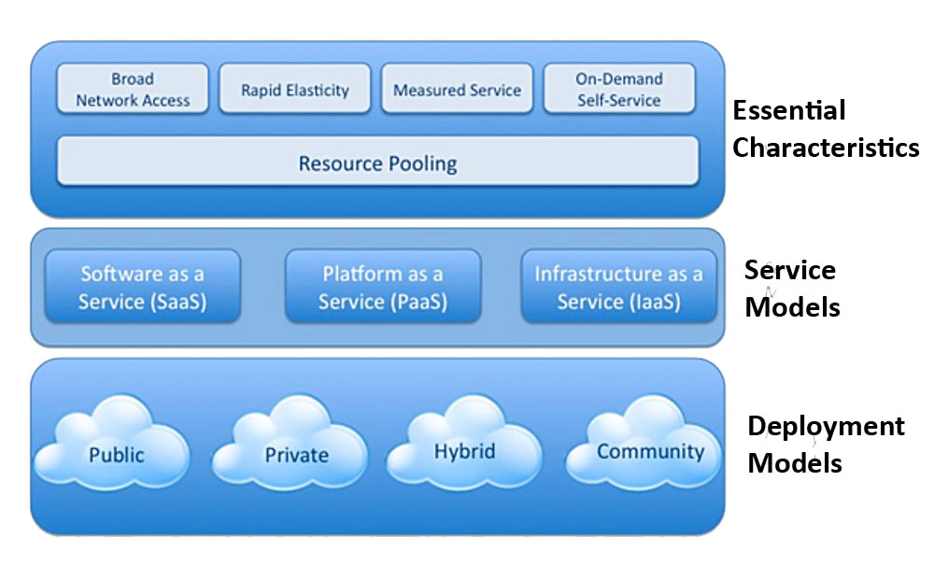
Cloud Computing: Definition

Slide 6
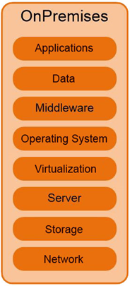
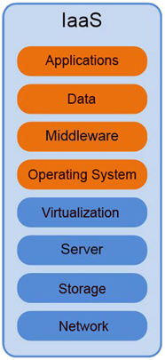
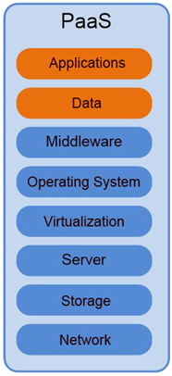
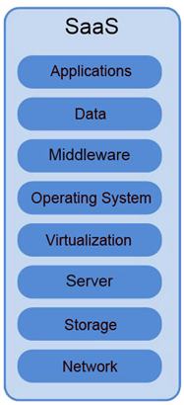
Cloud Computing: On-premises vs Service Models

Slide 7
Cloud Computing: Advantages & Disadvantages
Advantages
Flexibility
Availability
Accessibility
Scalability
Multi-tenancy
Disaster Recovery
Cost of ownership
Metered Services
Disadvantages
Downtime
Vulnerability to attack
Security

Slide 8
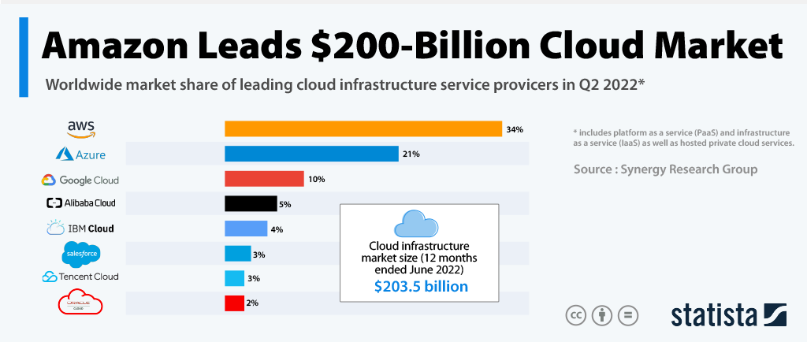
Cloud Computing: Cloud Computing Providers

Slide 9
Overview of AWS

Slide 10
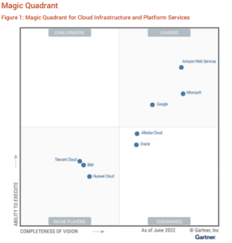
Why AWS
Gartner June’ 22 magic quadrant for Cloud Infra, AWS is the leader in the Cloud Computing market.
Gartner says, AWS is the most mature, enterprise-ready provider, with the deepest capabilities for governing a large number of users and resources.
AWS dominates the public cloud market with a 34% market share (Q2 2022).
AWS is the most popular public cloud infra platform, comprising 34 % of workloads (Q2 2017 report).
AWS certification is fast becoming the must have certificates for any IT professional working with Cloud.

Slide 11

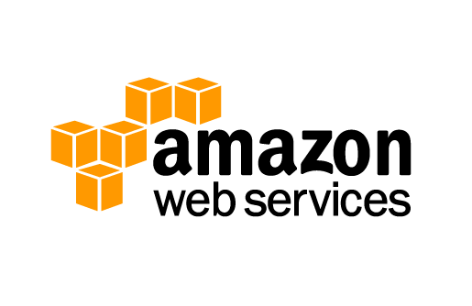
What is AWS
Amazon Web Services (AWS) is a subsidiary of Amazon.com that provides on-demand cloud computing platforms to individuals, companies and governments, on a paid subscription basis.
Enable businesses and developers to use web services to build scalable, sophisticated applications.
Storage
Development and Management Tools
Analytics
Content Delivery
Messaging
Compute
Database
App Services
Payments
Mobile
Networking
On-Demand Workforce
VPC

Slide 12
AWS: Benefits
Trade capital expense for variable expense
Benefit from massive economies of scale
Increase speed and agility
Stop guessing about capacity
Stop spending money running and maintaining data centers
Go global in minutes

Slide 13
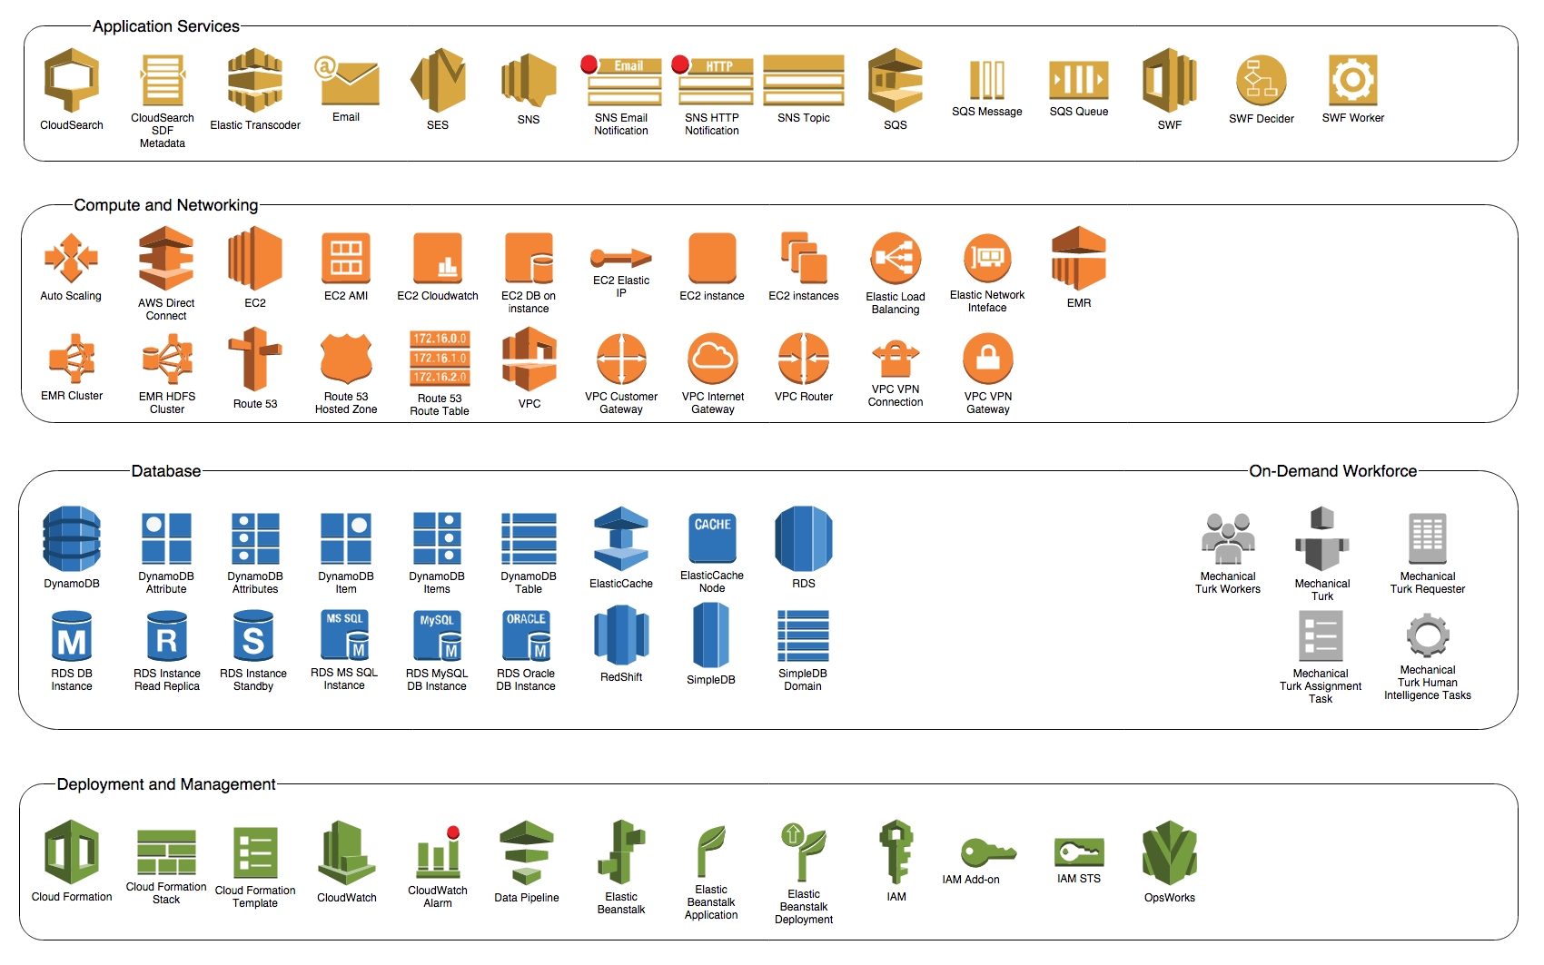
AWS: Services

Slide 14













AWS: Traditional vs AWS Components
Traditional Infrastructure Amazon Web Services
Security
Security
Security
Firewalls
ACLs
Administrators
Security Groups
NACLs
IAM
Security Groups
NACLs
Access Mgmt
Network
Network
Networking
Router
Network Pipeline
Switch
“Public”
ELB
VPC
Provision
EC2 “Classic”
VPC
On-Demand
ELB
VPC
Servers
Operating System
On-Premises Servers
AMI
EC2 Instances
DAS
SAN
NAS
Storage
EBS
EFS
S3
AWS Technical Essentials 3.8 ILT
RDBMS
No SQL
Database
RDS
Dynamo DB

Slide 15
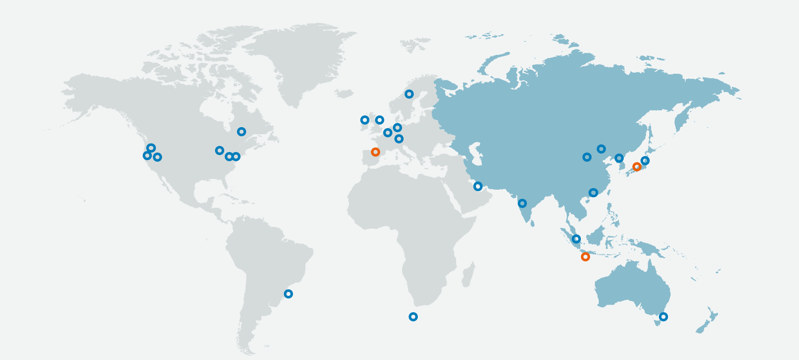
AWS: Global Infrastructure
The AWS Cloud operates 76 Availability Zones within 24 geographic Regions around the world, with announced plans for 9 more Availability Zones and 3 more Regions.
@May 2020

Slide 16
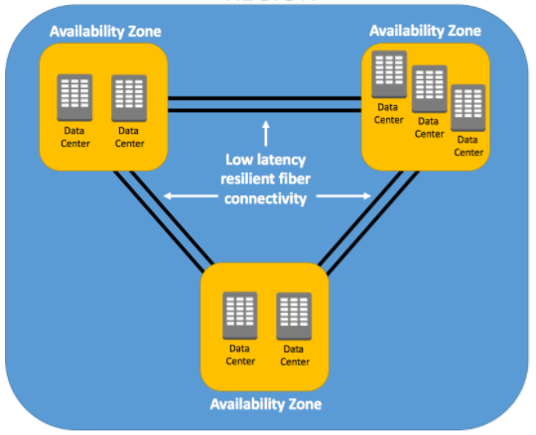
AWS: Availability Zone
High Availability Through Multiple Availability Zones.
In each region there will be at least two availability zones for fault tolerance.
An AZ is a combination of one or more data centers in a given region.
It is a logical grouping of data centers in a given region for service high availability.
A datacenter is a location where actual physical data resides.
A single or couple of data centers are clubbed in to one AZ.

Slide 17
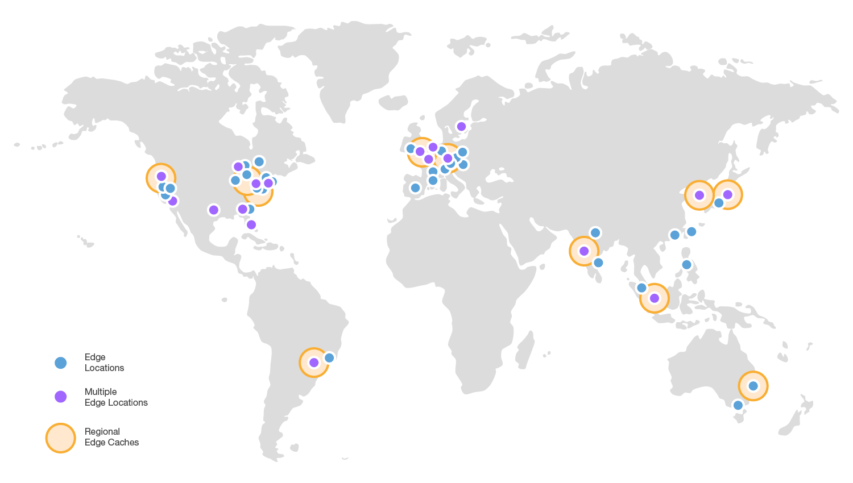
AWS: Edge Locations
The AWS have global network of 98 Edge locations (87 Points of Presence and 11 Regional Edge Caches) in 50 cities across 23 countries.

Slide 18
AWS: How to access the Services
AWS Management Console
AWS Command Line Interface (CLI)
Software Development Kits (SDK)

Slide 19
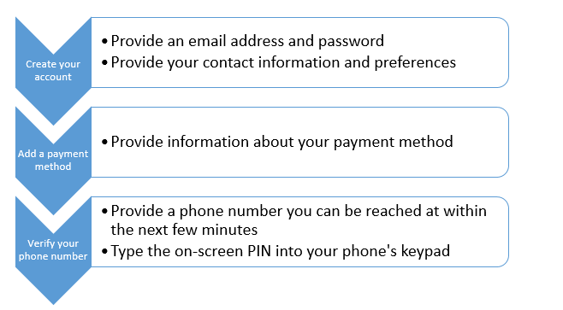
Hands-on Lab: Sign-up AWS Account
Create and activate a new Amazon Web Services account
https://aws.amazon.com/free/
Payment method:
Credit or Debit Card
Support plan:
Basic
Accounts are usually activated within a few minutes, but account activation can take up to 24 hours.
When your account is fully activated, you'll receive confirmation email. After you receive this email, you should have full access to all AWS services.

Slide 20
AWS Command Line Interface(CLI)
Open source tool that enables you to interact with AWS services using commands in your command-line shell.
Very minimal configuration required .
Supports below terminal program
Linux shells – Use common shell programs such as bash, zsh, and tcsh to run commands in Linux or macOS.
Windows command line – On Windows, run commands at the Windows command prompt or in PowerShell.
Remotely – Run commands on Amazon Elastic Compute Cloud (Amazon EC2) instances through a remote terminal program such as PuTTY or SSH, or with AWS Systems Manager.
Ref:https://aws.amazon.com/cli/

Slide 21
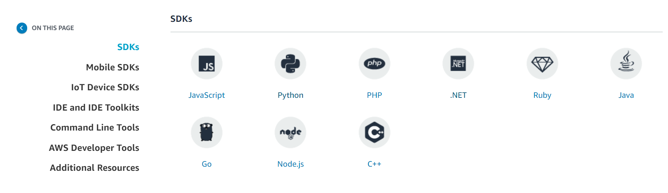
AWS SDKs and tools
Access and manage AWS services with your preferred development language or platform.
Ref:https://aws.amazon.com/getting-started/tools-sdks/

Slide 22
Quiz
1. Who is responsible for security of the Cloud according to the Shared-Responsibility Model?
AWS
Customer
2.Which category of services includes Amazon S3?
Compute
Migration
Networking
Storage
3. Which of the following is a responsibility of the customer according to the Shared-Responsibility Model?
Physical security of the facilities in which the services operate
AWS Identity and Access Management (IAM)
Availability of third-party audit reports
Protection of global infrastructure

Slide 23
Quiz
4. Which of the following is the best practice for adding an additional layer of security when logging into the AWS Management Console?
Secondary username
Multi-factor Authentication (MFA)
Root Access Permission
5. Which component of the AWS Global Infrastructure support the caching of content for faster access?
Edge Locations
Availability Zone
AWS Direct Connect Locations
Regions
6.Which method would you use to access AWS services through an easy-to-use graphical interface?
AWS Management Console
AWS Command Line Interface (AWS CLI)
AWS Software Development Kits (SDKs)

Slide 25
AWS CLI

Slide 26
Overview of AWS CLI
The AWS Command Line Interface (AWS CLI) is an open source tool that enables you to interact with AWS services using commands in command-line shell.
Enables to start running commands from the command prompt in terminal program:
• Linux shells – Use common shell programs such as bash, zsh, and tcsh to run commands in Linux or macOS.
• Windows command line – On Windows, run commands at the Windows command prompt or in PowerShell
.
• Remotely – Run commands on Amazon Elastic Compute Cloud (Amazon EC2) instances through a remote terminal program such as PuTTY or SSH, or with AWS Systems Manager.
2 Versions are Version 2.x and Version 1.x

Slide 27
Benefits of AWS CLI
Easier to install : One huge benefit of AWS CLI is that installation is smooth, quick, simple, and standardized.
Supports all Amazon Web Services: Lets you control all the services from one simple tool.
Saves time: GUIs are great when you’re just learning the ropes of a system. Once you get up and running, the user-friendly graphical interface tools start to stand in your way.
Scripting: The ability to automate control of all Amazon’s web services with scripts is possibly the biggest benefit.

Slide 28
Basic Commands
An AWS CLI command has the following structure:
$ aws <command> <subcommand> [options and parameters]
For example, to list S3 buckets, the command would be:
$ aws s3 ls
To view help documentation, use one of the following:
$ aws help
$ aws <command> help
$ aws <command> <subcommand> help
To get the version of the AWS CLI:
$ aws --version

Slide 29
Thanks

Slide 30
Thank You

